Slide 1

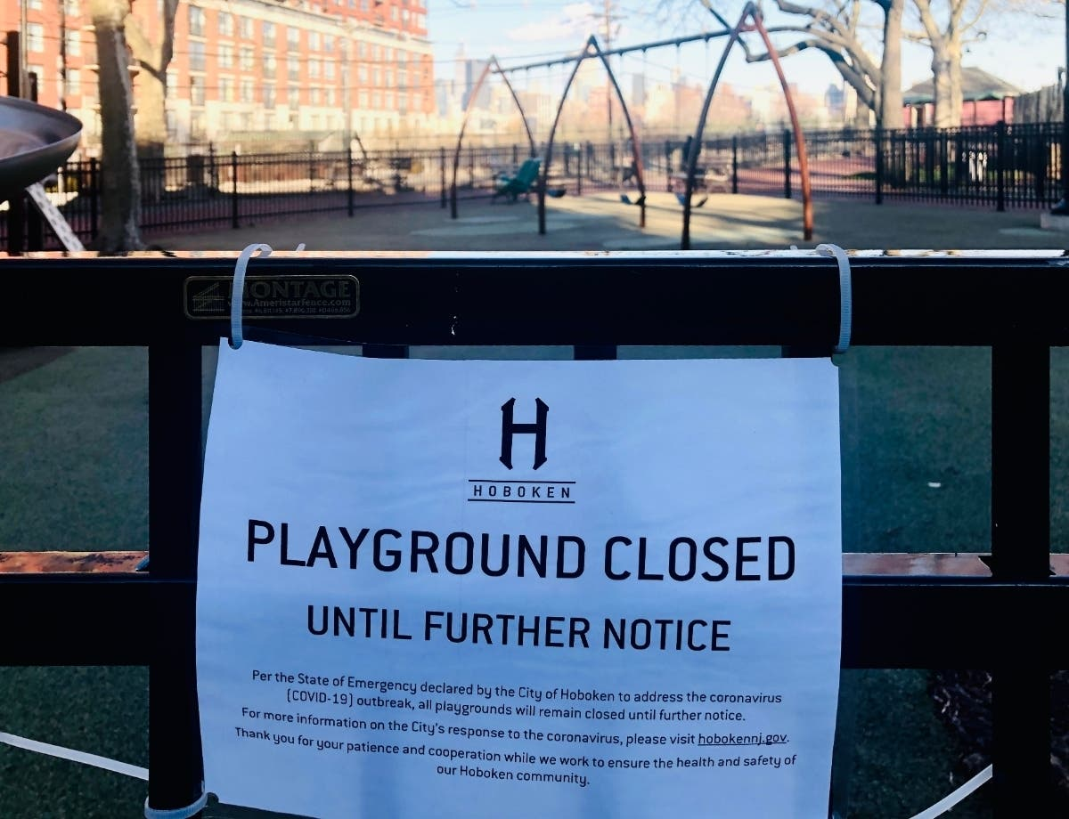
Park Closure Status in NYC Due To COVID-19
ALIJON FATOEV

Slide 2
The Impact Of COVID-19 on parks and playgrounds
The COVID-19 pandemic has disrupted many aspects of human social life, limiting recreational opportunities and affecting peoples’ financial security.

Slide 3
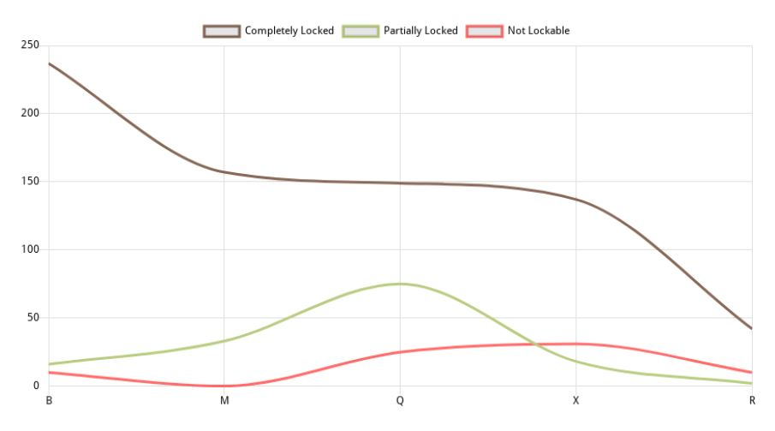
Line Chart
Tha linear chart provides us with evidence that most of the public parks in New York were closed due to the pandemic situation created by the spread of Covid-19. The left [vertical axes] shows the number of parks included in the database, while the horizontal [x axes] shows the boroughs in New York

Slide 4
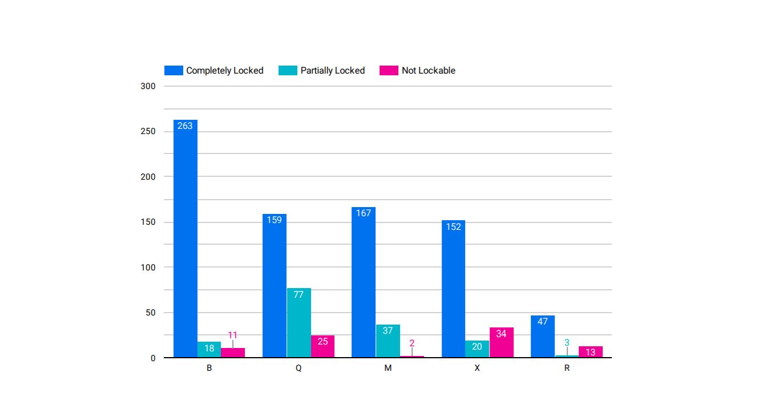
Bar Chart
This bar chart depicts the number of parks and playgrounds that were completely locked, partially locked and open. The broughs is plotted on the horizontal axis, and each bar’s height corresponds to the number of the parks and playgrounds in each brough

Slide 5
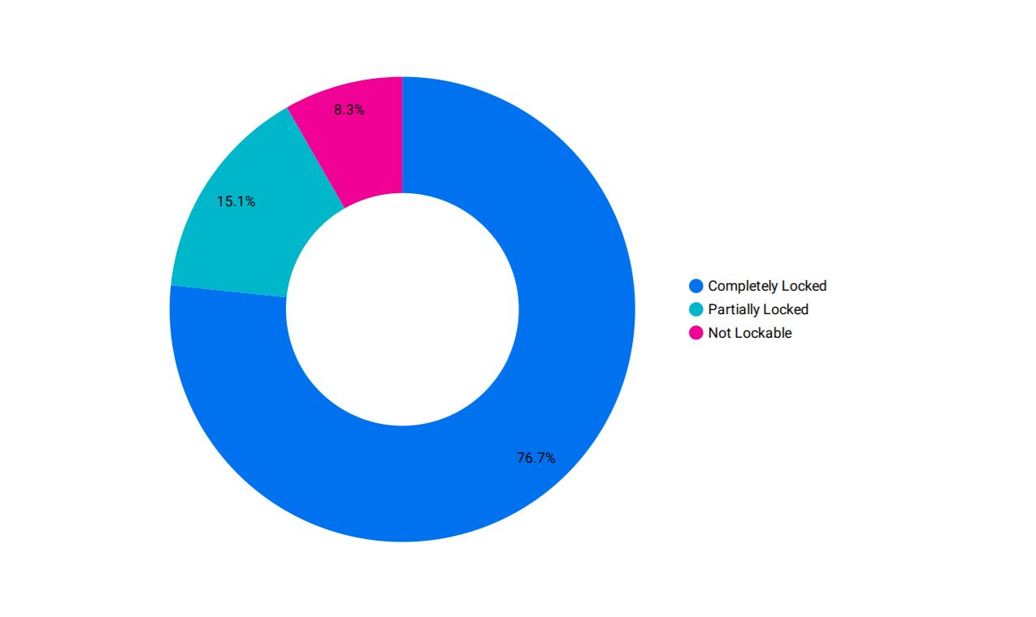
Donut Chart
This is s pie chart consist of 3 area large blue area resembles the public parks and playgrounds in New York that were completely locked due to covid-19.The pink area represents the percentage of open parks and playgrounds .The parks and playgrounds were partially locked shown in light blue area.

Slide 6
THE END

